Slide 1
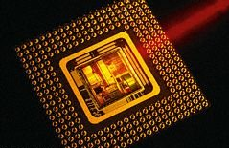
AC22005
Architecture - Revision

Slide 2

Thought for the Day

Slide 3

Thought for the Day

Slide 4

Thought for the Day

Slide 5
Architecture - The Big Picture
… building on earlier work

Slide 6
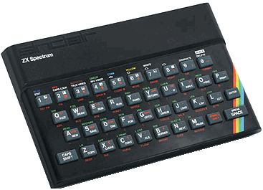
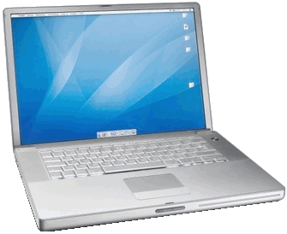
Overview
64-bit
4,000,000K RAM
2,000MHz clock
multiple buses
operating system
caches
pipelines
virtual memory
multi-core
(network)
We started here …
8-bit
16K RAM
1MHz clock
one set of buses
BASIC interpreter
… and ended up here

Slide 7
The Big Picture
Based on our earlier model of a “simple” microcomputer, we saw in AC22005 how:
  to increase performance through increased complexity in various ways
  these more complicated structures generated their own problems
  these new problems were overcome
We applied this algorithm to processors, memory, I/O and whole workstations!

Slide 8
Repeat after me …
It’s all about speed!

Slide 9


The King of Speed
“the number of transistors on integrated circuits doubles approximately every 2 years”

Slide 10
In the Beginning ...
… a “conventional” microcomputer with a “conventional” CPU

Slide 11
So ...
Processor and microcomputer structure works adequately. Clock speeds increasing (Moore’s Law), but want performance to rise even faster … so …
introduce some techniques which will improve the performance (these will increase architectural complexity, but this is not really important) … but …
our techniques need to be implemented wisely otherwise we might decrease performance!

Slide 12
… for better results ...
  process instructions in parallel:
    pipelining
    multi-core / multi-processor
  use multi-level memory:
    fast caches mean fewer slow fetches
    CPUs can use their own cache rather than main memory
    need memory management for the rest
  use multi-level computer architecture:
    different buses for slow(er) devices
    use appropriate I/O techniques
    buffer I/O to speed up transfers

Slide 13
REAL parallel processing
… using instruction pipelining

Slide 14
Problems in the pipeline
Pipelines can encounter problems:
  inter-dependent instructions
  branching
Sophisticated processors can cope with even these problems e.g. using Branch Target Buffers to improve branch prediction.
Multiple pipelines also possible, with queuing!
Also multi-core - what’s the difference between two pipelines and two cores???

Slide 15
Multi-level memory
… there’s never enough cache!

Slide 16
Multi-level memory
The speed/cost trade-off results in a hierarchical memory structure within PCs:
CPU registers
L1 Cache
L2 Cache
Increasing size
Increasing speed
Main memory
Hard disk storage
Backup storage

Slide 17
Why have a cache?
The cost of memory is usually related to its speed - faster memory is more expensive.
We would like the processor to have access to fast memory, but usually cannot afford a large amount of fast memory.
Thus we can use a small amount of fast memory structured as a cache, and use slower (cheaper) memory for the bulk of our main memory.
Reduces the “von Neumann bottleneck”.

Slide 18
Cache Mapping
In order to address memory, we need to map the main memory space and (much smaller) cache space together.
When a memory address is requested, the cache controller must check for this in the cache.
There are three main cache mapping methods:
  direct mapping
  fully associative mapping
  N-way set associative mapping

Slide 19
Multi-level means ...
… multiple ways of doing things, and need to move data between levels … thus we need …
memory management!

Slide 20
Memory Management Aims
Core aim is to bring programs and data from secondary storage (usually hard disk) into main memory ready to be run.
To do so, the following sub-aims are highly desirable:
  Protection
  Sharing
  Relocation

Slide 21
Memory management
To facilitate memory management, the main memory is usually “virtually” split into sub-areas using partitioning, segmentation or paging.
Use of paging itself facilitates the use of “virtual memory” – extending the size of the main memory by using the “real” part (RAM) together with a “virtual” part (hard disk storage).

Slide 22
Multi-level microcomputer
… make sure you get on the right bus!

Slide 23
I/O is a (necessary) pain
I/O is always very much slower than memory operations, so I/O needs to be handled carefully to minimise impact on the overall speed of the system:
  use an appropriate I/O method (interrupts and DMA usually)
  use I/O buffering
  use multiple bus architecture for different types of I/O devices

Slide 24
I/O Buffering
Buffering is a method of performing the I/O of a process at the same time as the computations done by the process.
For input, after the process has obtained some data and is about to start doing some calculations on the data, the CPU arranges for the next chunk of data to be transferred.

Slide 25
What You Should Know
… to pass the exam!

Slide 26
The Essentials - 1
  be able to describe the fetch-execute cycle and its limitations
  be able to describe instruction pipelines and justify their use
  be able to describe the memory hierarchy in a microcomputer, and justify its existence
  be able to describe the function & operation of a memory cache, and justify its use
  be able to describe the programmer’s model including instruction sets

Slide 27
The Essentials - 2
  be able to describe the aims of memory management and its implementation
  be able to describe the different methods of performing I/O, and the relative merits of each
  be able to describe I/O buffering and justify its use
  be able to perform relevant calculations in any of these areas!

Slide 28
Before you leave the exam
  Ensure your name, matric number and other details are on ALL exam books used
  Use a SEPARATE BOOK for sections 1 and 2
  Fold over the top-right corner (DON’T stick it down) … if it’s a “down the side” book, leave the flap alone!
  Fill in the table with the numbers of questions you have answered (just 1 etc., NOT 1(a), 1(b) etc.)
  You may take away the question paper if you wish

Slide 29
Some common mistakes
The following derive from previous exam answers:
  don’t say instruction when you mean process
    processors handle instructions only, a process is an OS concept
  don’t say disk when you mean memory
    both store data, but a disk is used in a fundamentally different way from the memory
  don’t say file when you mean memory
    the contents of a file must be loaded into memory to be accessed, thereafter treated as data in memory
  don’t say file when you mean process
    a file is a group of data items on a disk, a process is a chain of instructions

Slide 30
Some common mistakes
The following derive from previous exam answers:
  the CPU is “aware” only of instructions, it has no concept of processes whatsoever
    instructions are a processor-level concept, processes are an OS-level concept
  the ease and speed of memory access is not improved (or otherwise) by different segmentation methods – particular OSs select a particular method and stick to it
    the speed of memory access is fixed by the hardware, and every memory location takes the same time to access*
* different types of memory chip may have different access times, but these times will be fixed for a given system and cannot be changed by the user

Slide 31
Some common mistakes
The following derive from previous exam answers:
  in a multi-process environment, the CPU is constantly processing instructions, and it cannot be speeded up - it’s always going flat out*
    though some CPUs can be slowed down (to save power)
  memory management is needed because of multiple processes, not because of multiple processors (it’s needed in single CPU systems)
  memory management was not needed in early machines because they only had one process, not because of their smaller memory
* you can overclock your PC, but this requires hardware-level intervention

Slide 32
Any problems?
  in any particular topics?
  in any previous exam papers?
irmurray@computing.dundee.ac.uk

